Slide 1


Movie Review Application
Prajwal Surve

Slide 2
Contents
Introduction
Objective
Software Requirements
Features
Future Enhancements
Conclusion

Slide 3
Introduction
Welcome to the presentation on Movie Review Application ,a tool for movie enthusiasts and casual viewers alike
This application aims to provide ways to discover ,rate and review movies , making your film experience more enjoyable and informed

Slide 4
Objective
This application aims to provide wide variety of movies from different genres ,language ,release years
To enable viewers to make a informed decision about which movie to watch using real-time review and ratings from reviewers.

Slide 5
Software Requirements
Programming Language
Python
Django framework
Python Libraries
django_restframework
bs4
googleapiclient
widget_tweaks
crispy_forms
crispy_bootstrap5
Database
Sqlite3
CRUD operations
Software Platforms
Visual Studio Code
Python pip
Command Prompt

Slide 6
Feature Overview
User
Sign Up / Login
View Movies
Search Movies
View Reviews and Ratings
Add Review / Rating
Edit / Delete Review
Admin
Login
View /Delete Users
Add /Delete Movies
Add /Delete Actors
Add /Delete Genres
Search /Edit Movies
Delete Review

Slide 7
Key Features
Comprehensive Databases
Movie Discovery
Real Time Reviews And Ratings
User-Friendly Interface

Slide 8
E-R Diagram

Slide 9
User id
Name
Admin
Comment
User
Email id
Review id
rating
Refers to
Contact
Reviews
Rates
Refers to
Movie id
Movie
Language
Movie name
Country
Genre
Release Date
Cast

Slide 10
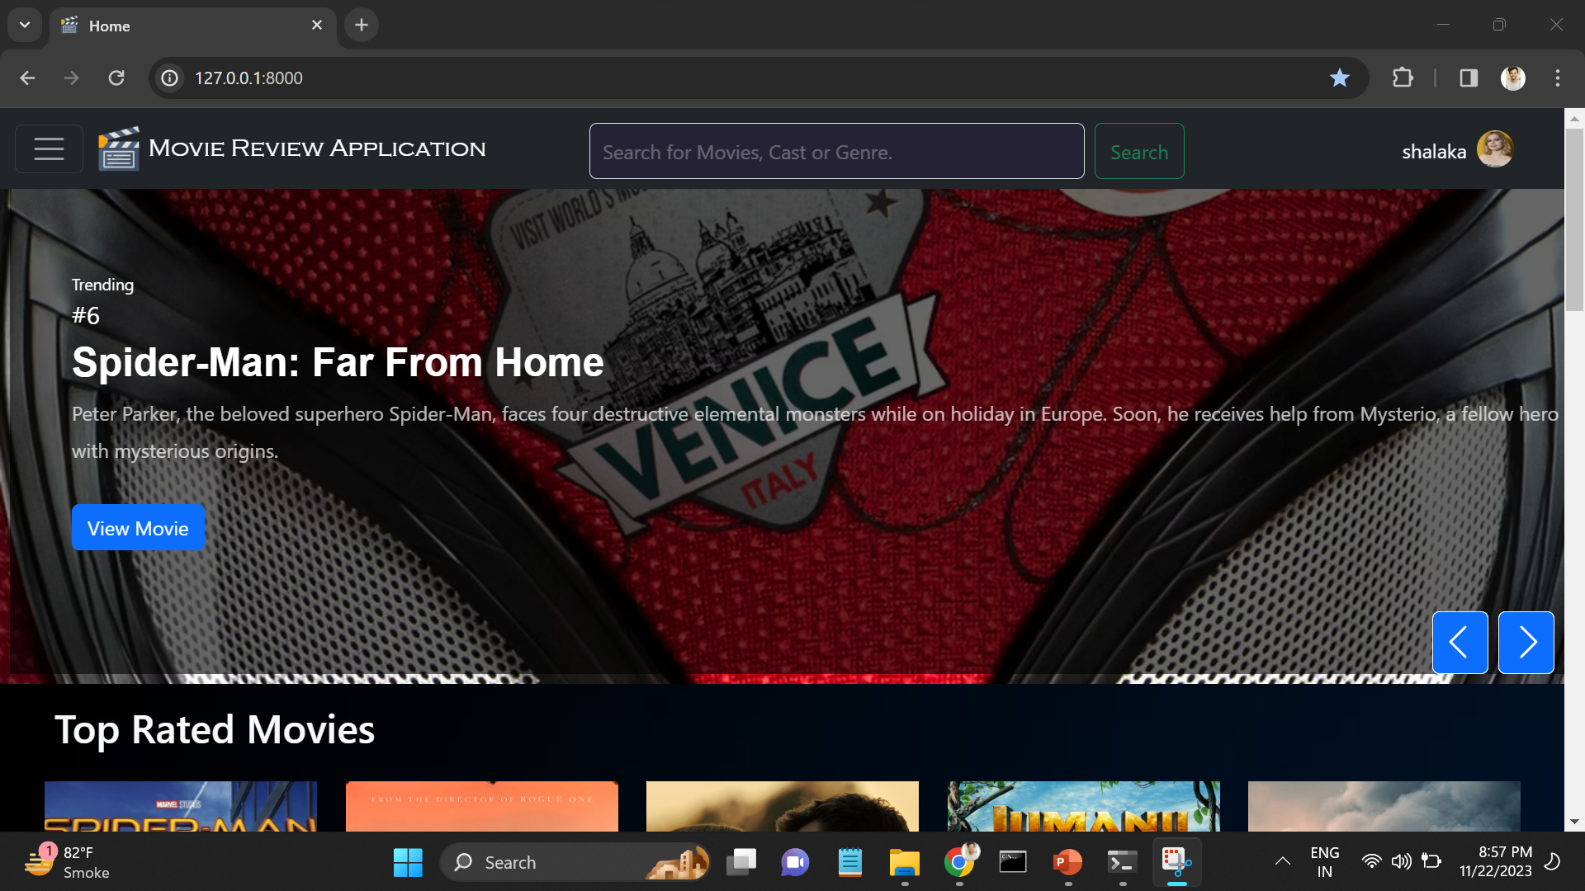
User Interface
Homepage

Slide 11
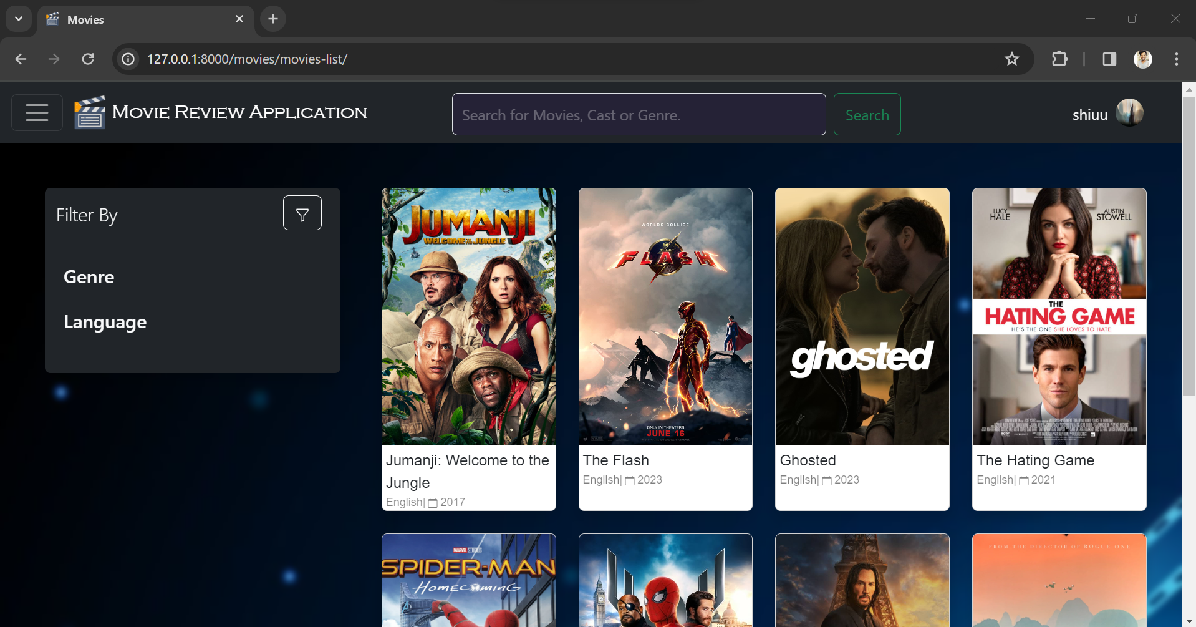
User Interface Movies Page

Slide 12
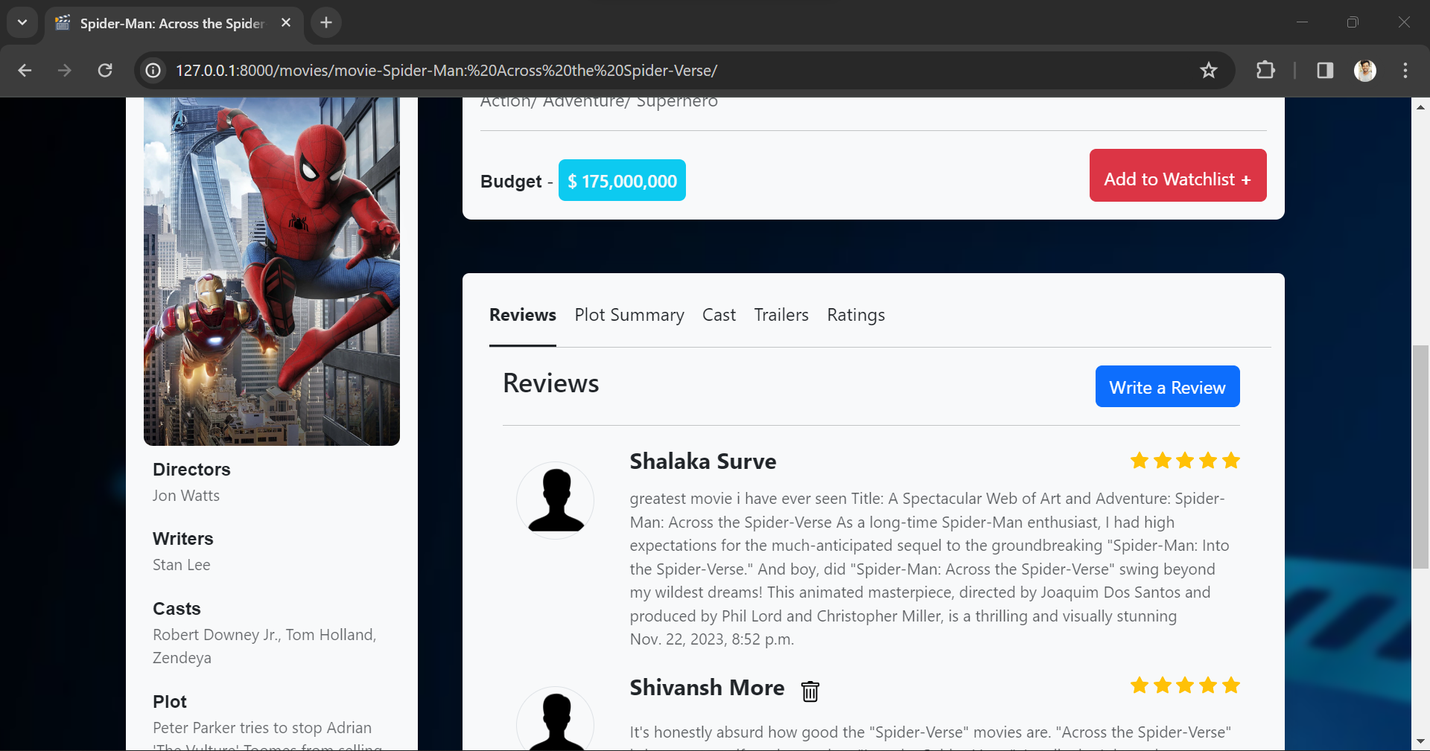
User Interface Movie Reviews

Slide 13
Future Enhancements
Email Validation using OTP
Sentiment Analysis
Personalized Recommendation

Slide 14
Conclusion
This application enhanced users film experiences by providing centralized movie database ,real time ratings and reviews . It enables informed decision making and movie discovery

Slide 15
Thank You

